Slide 1
Agenda:
Descriptive Statistics ( recap)
Probability Distribution
Discrete Probability Distributions:
A. Bernoulli
B. Binomial
C. Poisson
Continuous Probability Distribution:
Normal Distribution
3. Sampling

Slide 2
Random Variable
A variable is random if it takes on different values as result of the outcomes of a random experiment or is an experiment with random outcome.
Random variable is a variable related to a random event.
A random variable is discrete if it has a finite or countable number of possible outcomes that can be listed.
A random variable is Continuous if it has an uncountable number or possible outcomes within a given interval.

Slide 3
Types of Random Variable
Discrete Random variable
If a random variable is allowed to take only limited number of values, which can be listed, it is a discrete random variable.
A discrete random variable can assume only finite number of numerical values.
Eg: Number of students in statistics class.
Continuous Random Variable
If the RV is allowed to assume any value within a given range/interval, then it is a continuous random variable
A continuous random variable can assume infinite number of numerical values. These experimental outcomes are based on interval or ratio scale.
Eg: Waiting time for customer in ATM queue.

Slide 4
Random Variable Example
Breast cancer screening clinic, there is no way of know exactly how many women will be screened on any one day.
Tomorrow's number of patients is a random variable , and the values of the random variable are numerical assignments to each possible outcome of the random experiment.
As per the past records, if the daily number of patients ranges between 100 to 115, then the random variable is a discrete random variable.
Average waiting time taken for a patient to get screened is a continuous random variable.

Slide 5
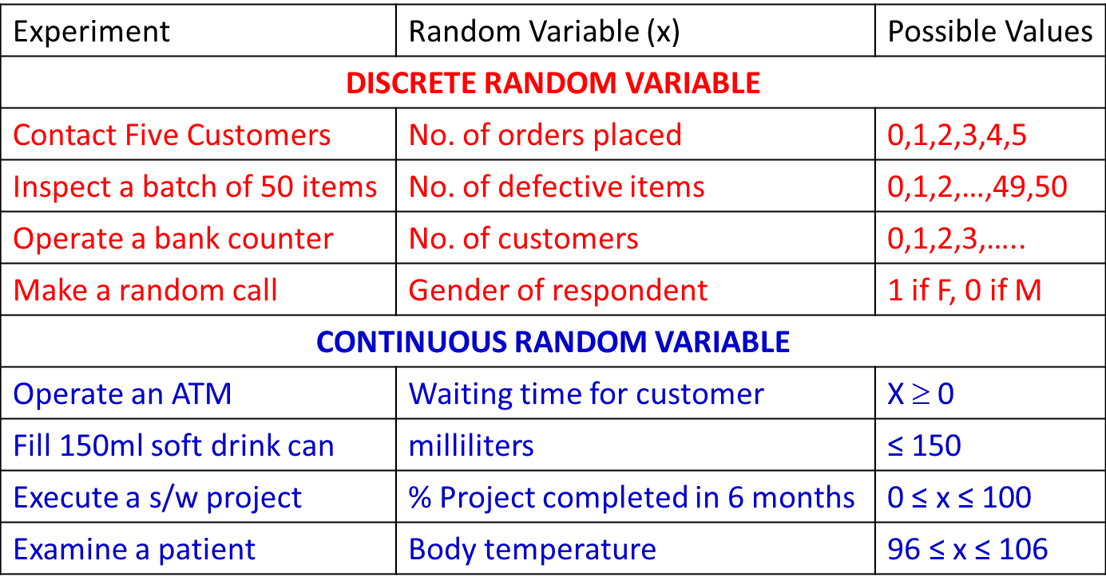
Random Variable – More Examples

Slide 6
Probability

Slide 7
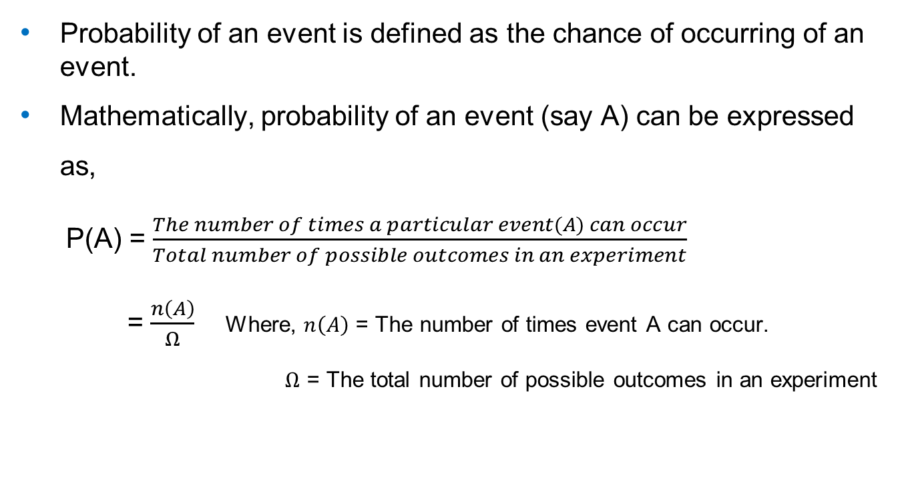
Probability
Probability of an event is defined as the chance of occurring of an event.
Mathematically, probability of an event (say A) can be expressed as,
P(A) = $\frac{The number of times a particular event(A) can occur}{Total number of possible outcomes in an experiment}$
= $\frac{n\left(A\right)}{Ω}$ Where, $n\left(A\right)$ = The number of times event A can occur.
$Ω$ = The total number of possible outcomes in an experiment

Slide 8
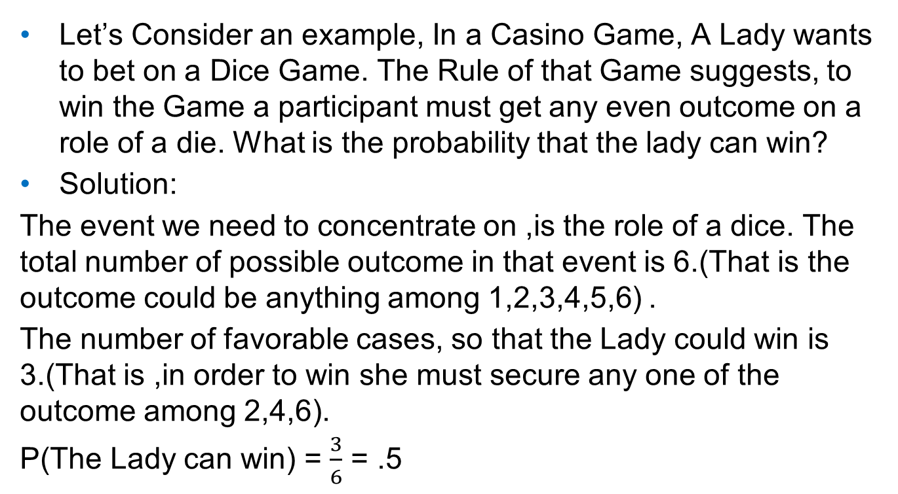
Example : Probability
Let’s Consider an example, In a Casino Game, A Lady wants to bet on a Dice Game. The Rule of that Game suggests, to win the Game a participant must get any even outcome on a role of a die. What is the probability that the lady can win?
Solution:
The event we need to concentrate on ,is the role of a dice. The total number of possible outcome in that event is 6.(That is the outcome could be anything among 1,2,3,4,5,6) .
The number of favorable cases, so that the Lady could win is 3.(That is ,in order to win she must secure any one of the outcome among 2,4,6).
P(The Lady can win) = $\frac{3}{6}$ = .5

Slide 9
Probability Distributions

Slide 10
Probability distributions
A probability distribution of a random variable X is a description of the probabilities associated with the possible values of X.
The representation of a variable with its relative frequency distribution is known as probability distribution.
A probability distribution for a random variable describes how probabilities are distributed for different values assumed by the random variable.
The variable could take discreet values or continuous values.
But the accumulative probability over all the values of the variable is 1.

Slide 11
Probability distributions – Coin Toss Example
All possible outcomes in 3 flips of a fair coin are,
X = Number of heads after 3 flips of a fair coin
All Possible Outcomes(In 3 Flips of a fair Coin)
HHH
HHT
HTH
THH
HTT
THT
TTH
TTT
All Possible Outcomes(In 3 Flips of a fair Coin)
HHH
HHT
HTH
THH
HTT
THT
TTH
TTT
3
2
1
0

Slide 12
Probability distributions – Coin Toss Example
X = Number of heads after 3 flips of a fair coin
X=Random Variable | Favorable Cases | Frequency | Probability | f(x) = probability
0 | TTT | 1 | 1/8 | .125
1 | TTH,THT,HTT | 3 | 3/8 | .375
2 | HHT,HTH,THH | 3 | 3/8 | .375
3 | HHH | 1 | 1/8 | .125
 |  |  |  | 1

Slide 13
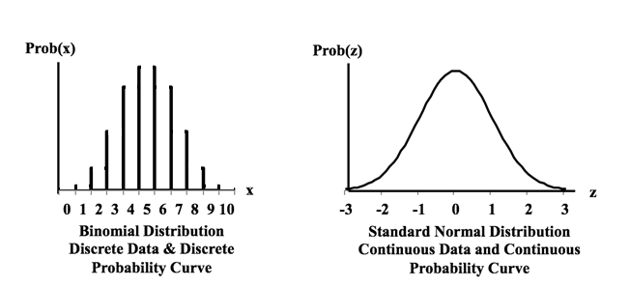
Types of Probability Distributions
Discrete Probability Distribution
Continuous Probability Distributions

Slide 14
Discrete Probability Distribution

Slide 15
Discrete Probability Distribution
The probability distribution for a random variable which takes discreet value is known as Discreet Probability Distribution..
It is a mutually exclusive list of all the possible numerical outcomes along with the probability of occurrence of each outcome.
Mean or Expected value of a discrete random variable
E(x) = μ = Σ xf(x)
Variance of a discrete random variable
Var(x) = σ² = Σ (x- μ)²f(x)

Slide 16
Probability Mass Function (PMF)
The probability distribution for a discrete random variable is described as probability mass function

Slide 17

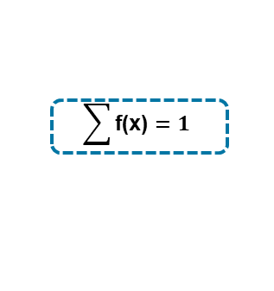
Rules for Discrete Probability Distribution or PMF – Example 1
All Possible Outcomes(In 3 Flips of a fair Coin)
HHH
HHT
HTH
THH
HTT
THT
TTH
TTT
[x ,f(x)] is said to constitute Probability Distribution if :
x is a random variable
f(x) > = 0
Σf(x) = 1
Data which satisfies this rules is a valid Probability distribution.
X=Random Variable | Probability | f(x) = probability
0 | 1/8 | .125
1 | 3/8 | .375
2 | 3/8 | .375
3 | 1/8 | .125
 |  | 1
f(x) > 0
$$\sum{\text{f}\text{(}\text{x}\text{)}}=1$$

Slide 18
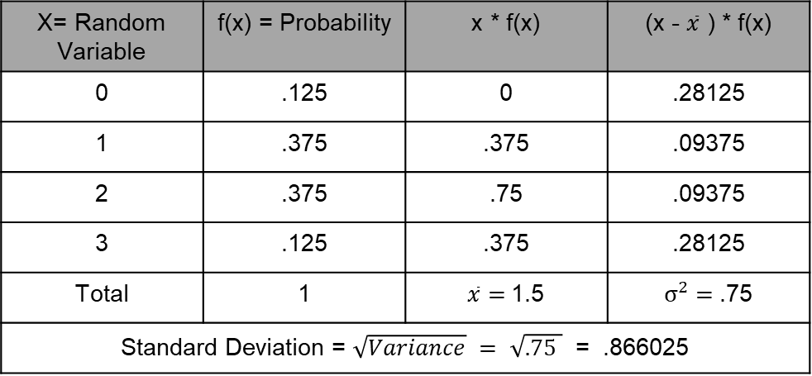
Calculate Expected value and Variance
Mean or Expected value of a discrete random variable
E(x) = μ = Σ xf(x)
Variance of a discrete random variable
Var(x) = σ² = Σ (x- μ)²f(x)
X= Random Variable | f(x) = Probability | x * f(x) | (x - $\overline{x}$ ) * f(x)
0 | .125 | 0 | .28125
1 | .375 | .375 | .09375
2 | .375 | .75 | .09375
3 | .125 | .375 | .28125
Total | 1 | $\overline{x}=$1.5 | $σ^{2}=$.75
Standard Deviation = $\sqrt{Variance} = \sqrt{.75 }$ = .866025

Slide 19
Discrete Probability Distribution – Example 2
Distribution of the number of interruptions per day in a large computer network.

Slide 20
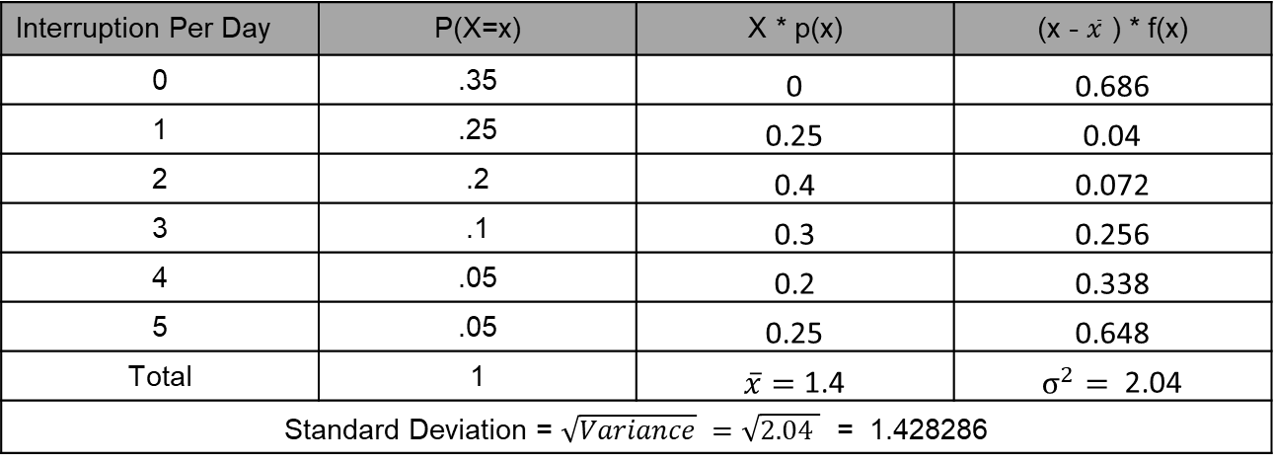
Discrete Probability Distribution – Expectation and Variance Calculation
Distribution of the number of interruptions per day in a large computer network
Mean or Expected value of a discrete random variable
E(x) = μ = Σ xf(x)
Variance of a discrete random variable
Var(x) = σ² = Σ (x- μ)²f(x)
Interruption Per Day | P(X=x) | X * p(x) | (x - $\overline{x}$ ) * f(x)
0 | .35 | 0 | 0.686
1 | .25 | 0.25 | 0.04
2 | .2 | 0.4 | 0.072
3 | .1 | 0.3 | 0.256
4 | .05 | 0.2 | 0.338
5 | .05 | 0.25 | 0.648
Total | 1 | $\overline{x}=$ 1.4 | $σ^{2}=$ 2.04
Standard Deviation = $\sqrt{Variance} =\sqrt{2.04 }$ = 1.428286

Slide 21
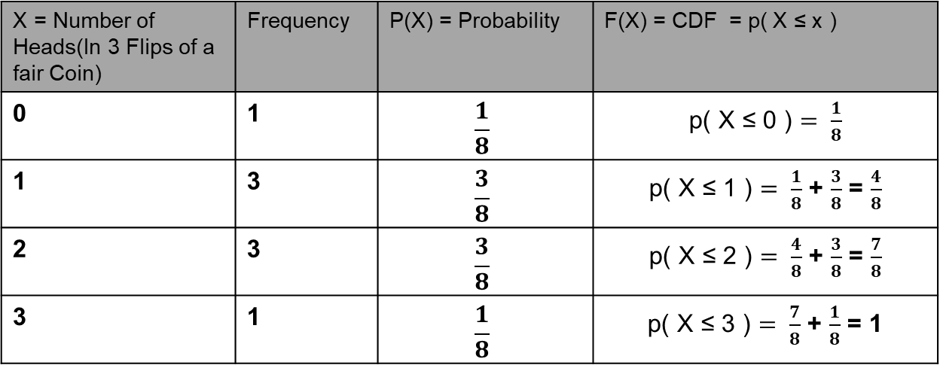
Cumulative Distribution Function – CDF :
The cumulative distribution function (CDF) of a random variable is another method to describe the distribution of random variables.
For Example, The number oh Head in roll of a dice thrice,
The advantage of the CDF is that it can be defined for any kind of random variable (discrete, continuous)
X = Number of Heads(In 3 Flips of a fair Coin) | Frequency | P(X) = Probability | F(X) = CDF = p( X ≤ x )
0 | 1 | $$\frac{1}{8}$$ | p( X ≤ 0 ) $= \frac{1}{8}$
1 | 3 | $$\frac{3}{8}$$ | p( X ≤ 1 ) $= \frac{1}{8}$ + $\frac{3}{8}$ = $\frac{4}{8}$
2 | 3 | $$\frac{3}{8}$$ | p( X ≤ 2 ) $= \frac{4}{8}$ + $\frac{3}{8}$ = $\frac{7}{8}$
3 | 1 | $$\frac{1}{8}$$ | p( X ≤ 3 ) $= \frac{7}{8}$ + $\frac{1}{8}$ = 1

Slide 22
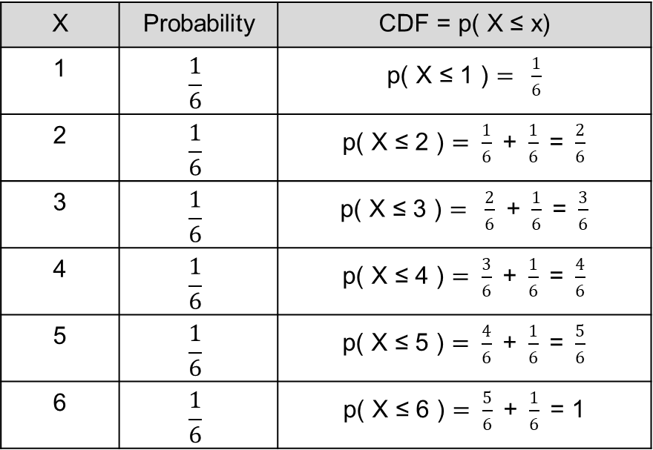
Cumulative distribution function (CDF)
Let’s consider an example: The outcome of a roll of a dice.
X | Probability | CDF = p( X ≤ x)
1 | $$\frac{1}{6}$$ | p( X ≤ 1 ) $= \frac{1}{6}$
2 | $$\frac{1}{6}$$ | p( X ≤ 2 ) $= \frac{1}{6}\text{ + }\frac{1}{6}\text{ = }\frac{2}{6}$
3 | $$\frac{1}{6}$$ | p( X ≤ 3 ) $= \frac{2}{6}\text{ + }\frac{1}{6}\text{ = }\frac{3}{6}$
4 | $$\frac{1}{6}$$ | p( X ≤ 4 ) $= \frac{3}{6}\text{ + }\frac{1}{6}\text{ = }\frac{4}{6}$
5 | $$\frac{1}{6}$$ | p( X ≤ 5 ) $= \frac{4}{6}\text{ + }\frac{1}{6}\text{ = }\frac{5}{6}$
6 | $$\frac{1}{6}$$ | p( X ≤ 6 ) $= \frac{5}{6}\text{ + }\frac{1}{6}\text{ =}\text{ 1}$
1.0
P(x)
5/6
2/3
1/2
1/3
1/6
1
2
3
4
5
6
x

Slide 23
Discrete Probability Distribution
Bernoulli
Binomial
Poisson

Slide 24
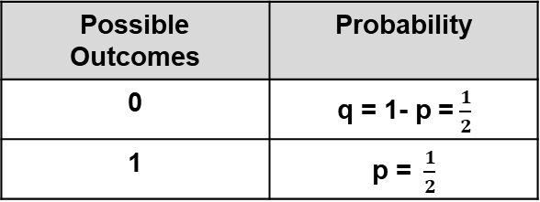
Bernouli Distribution
The probability Distribution of an event, which as only two mutually exclusive outcomes can be referred to as Bernoulli Probability Distribution.
One of the outcomes is known as success and the other one as failure.
Probability of Success is usually defined as p, where p is the probability of success and 0 < p < 1. and the probability of Failure is defined as 1 – p
Let’s consider an example : the number of Heads in toss of a coin.
Here an experiment is performed only once. i.e. the number of trial is 1.
Possible Outcomes | Probability
0 | q = 1- p =$\frac{1}{2}$
1 | p = $\frac{1}{2}$

Slide 25
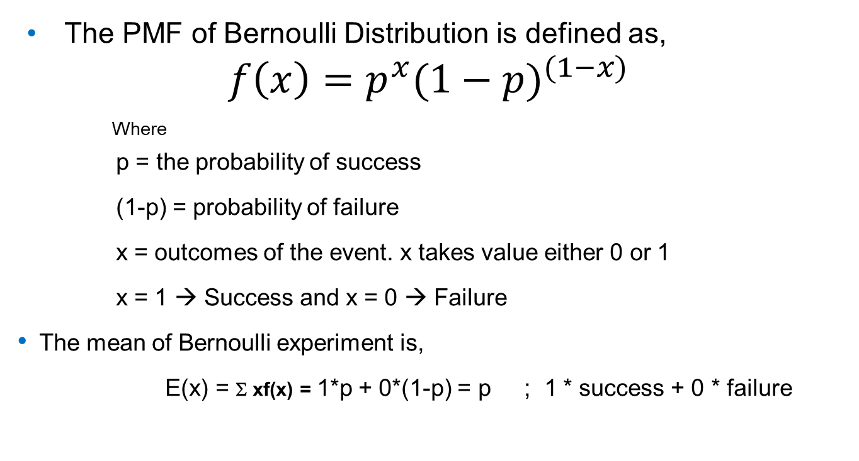
Bernouli Distribution
The PMF of Bernoulli Distribution is defined as,
$$f\left(x\right)=p^{x}{(1−p)}^{(1−x)}$$
Where
p = the probability of success
(1-p) = probability of failure
x = outcomes of the event. x takes value either 0 or 1
x = 1 → Success and x = 0 → Failure
The mean of Bernoulli experiment is,
E(x) = Σ xf(x) = 1*p + 0*(1-p) = p ; 1 * success + 0 * failure

Slide 26
Bernoulli Process
The variance of Bernoulli trial is
Var(x) =Σ (x- μ)²f(x) = (1-p)² * p + (0-p)² * (1-p)
= p –p³ –p² + p³
= p(1-p)
Please note
μ _{x±y} = μ_{x}± μ_{y}
σ²_{x±y} = σ²_{x} + σ²_{y}
Where, x & y are two independent events

Slide 27
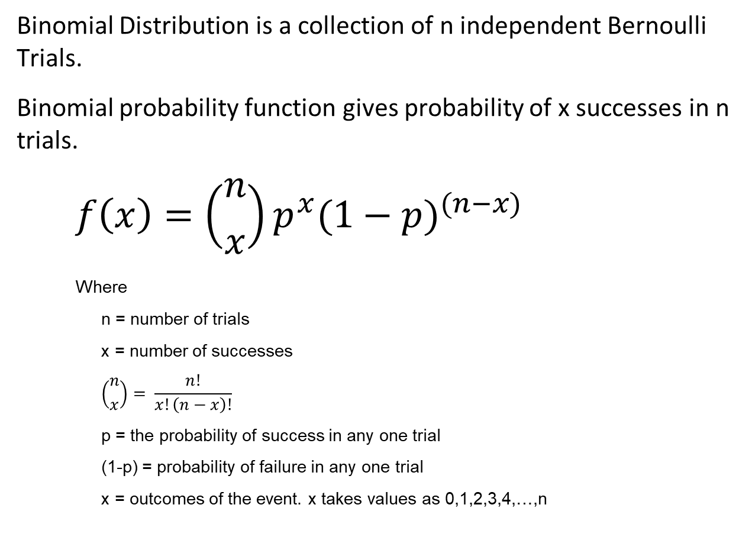
Binomial Probability Function
Binomial Distribution is a collection of n independent Bernoulli Trials.
Binomial probability function gives probability of x successes in n trials.
$$f\left(x\right)=\left({n \atop x}\right)p^{x}{(1−p)}^{(n−x)}$$
Where
n = number of trials
x = number of successes
$$\left({n \atop x}\right)= \frac{n!}{x!\left(n−x\right)!}$$
p = the probability of success in any one trial
(1-p) = probability of failure in any one trial
x = outcomes of the event. x takes values as 0,1,2,3,4,…,n

Slide 28
Binomial Distribution
Here an experiment is performed ‘ n ’ times. i.e. the number of trial is ‘ n ’. But ‘ n ’ should be finite and not to large.
This is an accumulation of n independent Bernoulli trials.
When the each trial of an experiment has only two possible outcomes.
One of the outcome in each trial is known as success and the other one is known as failure.
0 < Probability of success <1

Slide 29
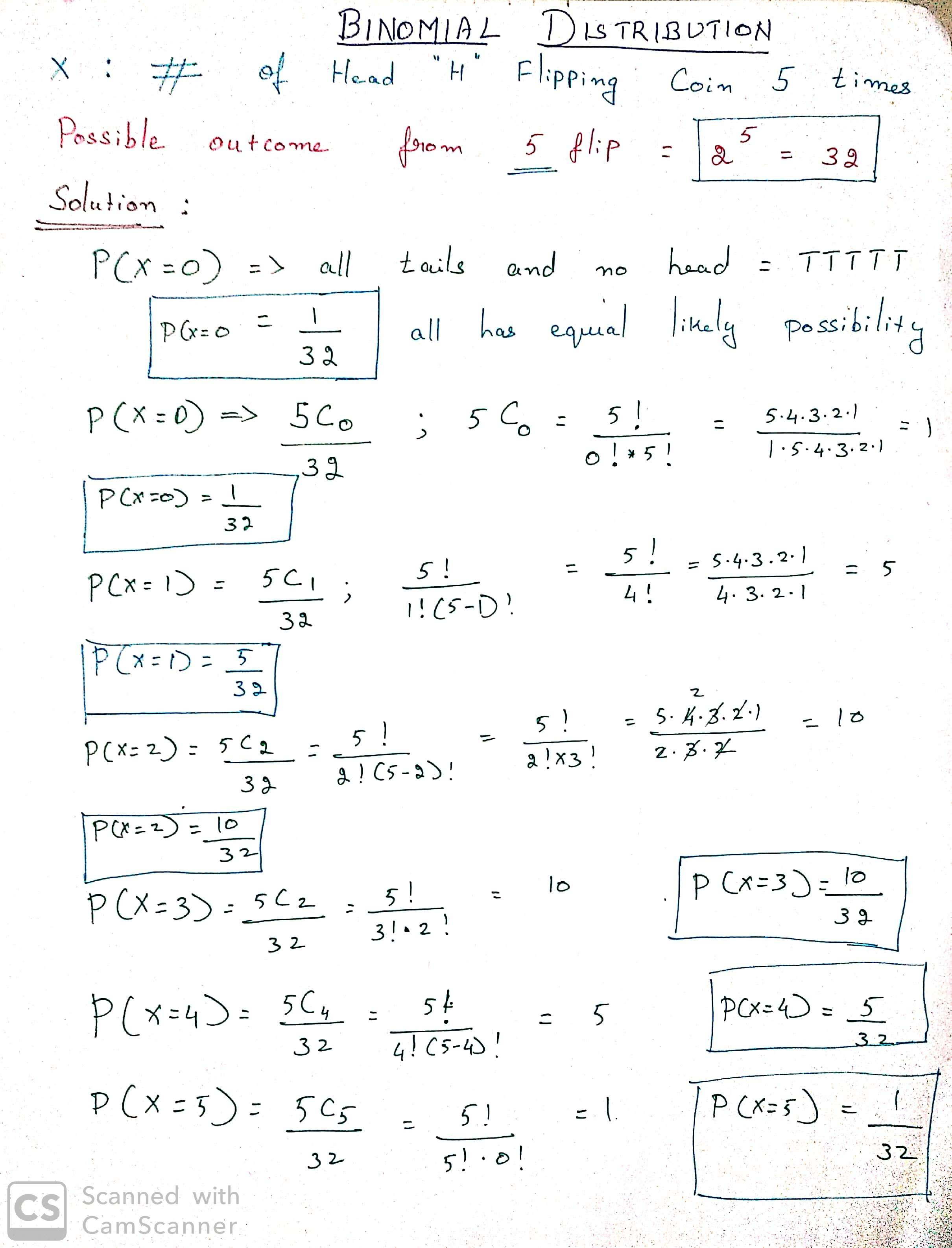

Slide 30
Mean and Variance of Binomial Distribution
A binomial experiment is a series of n Bernoulli trials. Therefore
μx = p + p + … n times = np
Let (1-p) = q then
For a Bernoulli trial
Var(b) = pq
For n trials
Var(x) = pq + pq + … n times = npq = np(1-p)

Slide 31
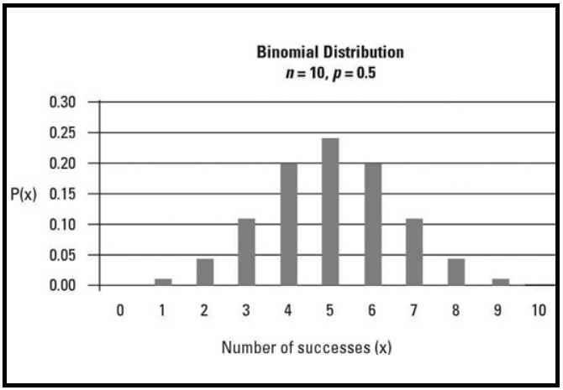
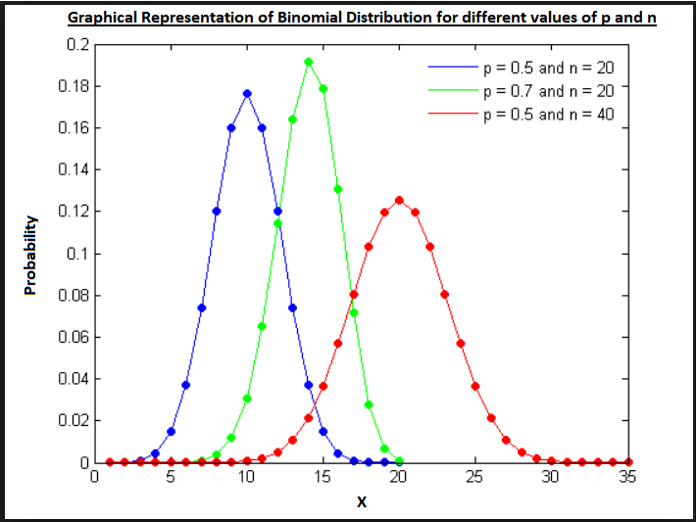
Mean and Variance of Binomial Distribution
The graphical representation of Binomial Distribution looks like

Slide 32
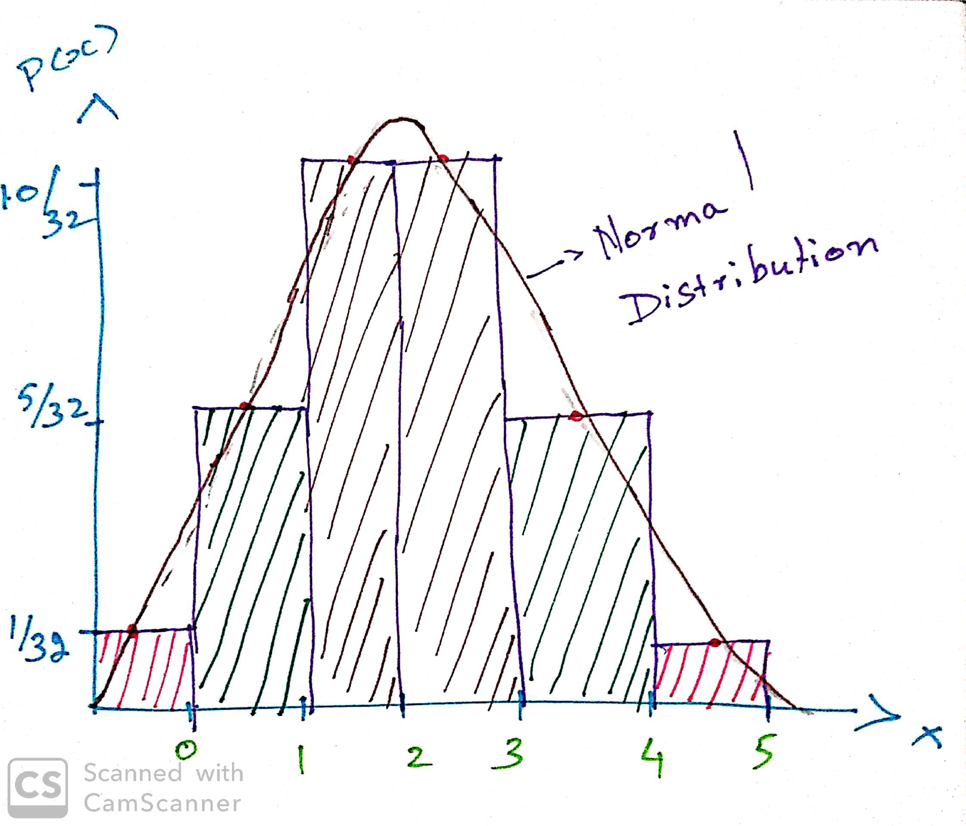
Binomial Distribution
If x is a random variable with distribution B(n, p), then for sufficiently large n, the following random variable has a standard normal distribution

Slide 33
Binomial - Martin Cloth store problem
On the basis of past experience Martin Cloth Store manager estimates that the probability of purchase by any customer is 0.3 and purchase decision of one customer does not influence the other. What is the probability of 2 of the next 3 customers will make a purchase?

Slide 34
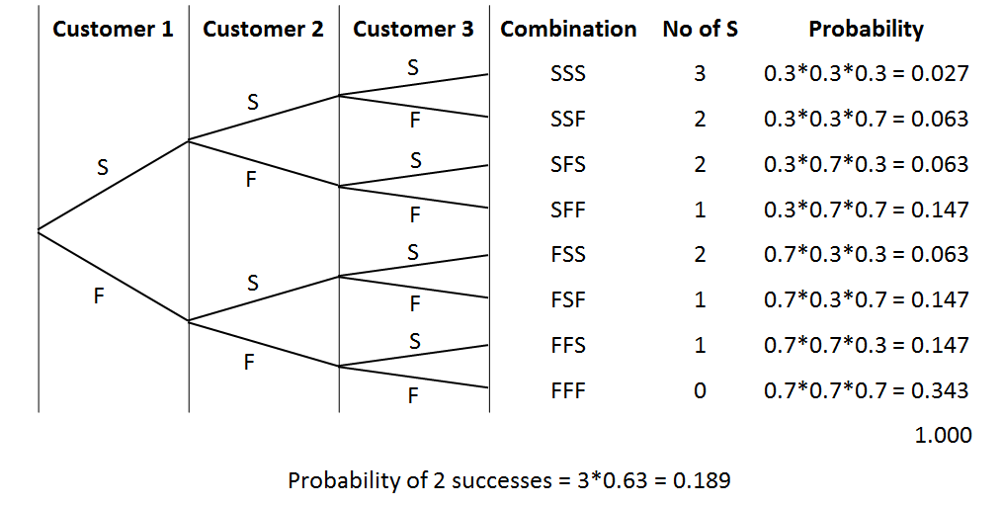
Binomial - Martin Cloth Store problem
3 *P^2 * (1-p)

Slide 35
Poisson Distribution

Slide 36
Poisson Distribution
A probability Distribution that is used to estimating number of occurrences over a specified interval of time or space.
A binomial distribution with large number of trials and low rate of success can be called as a Poisson Distribution. [By large number of trial we mean the number of trials should be greater than 20 & by low success rate we mean p < 0.5 ]
Properties of Poisson Probability Function
The probability of occurrence is same in two intervals of same length.
The probability of occurrence or non-occurrence is independent of occurrence or non-occurrence in any other interval.

Slide 37
Poisson Distribution – Business Examples
No. of Delayed flight by Indigo in a year..
No of collapsed flyover in India from 2012 to 2019
No. of calls coming to a call center in a given interval.
No. of spelling mistake in the first prof copy of a book published by a renowned publication
No. of defects in a length of cloth from a loom.

Slide 38
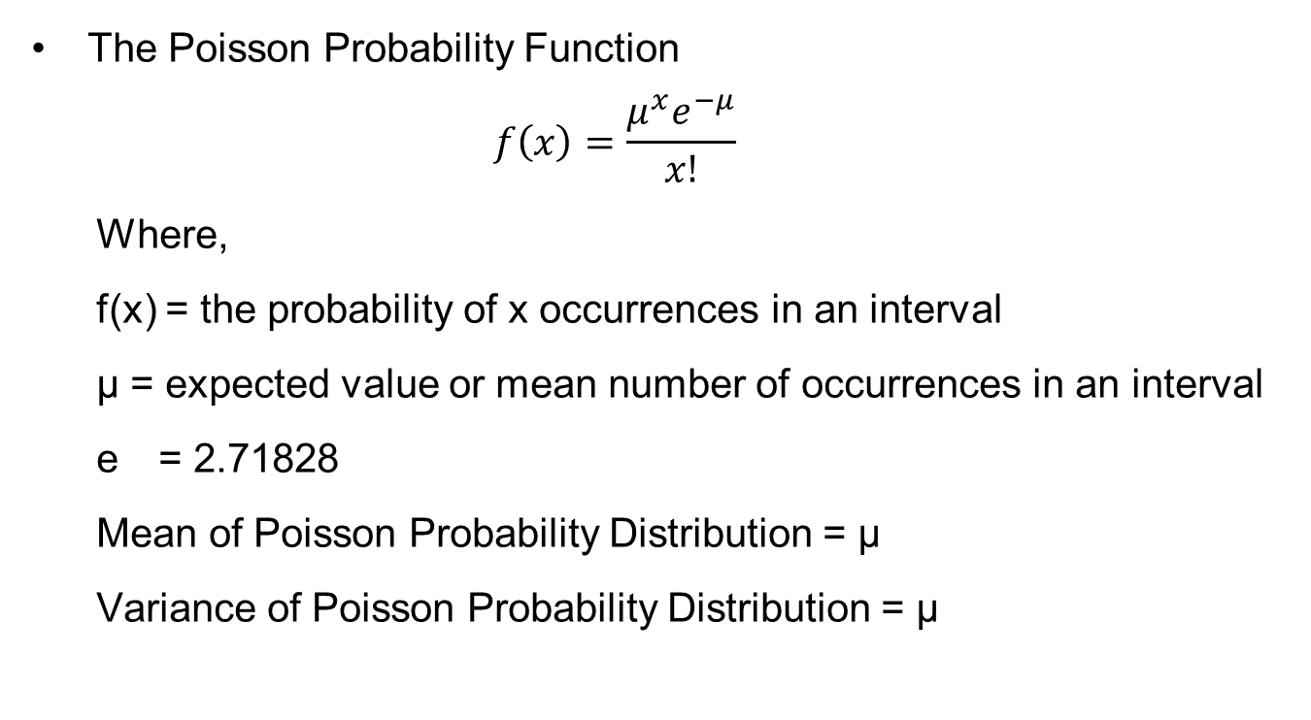
Poisson Probability Function
The Poisson Probability Function
$$f\left(x\right)=\frac{μ^{x}e^{−μ}}{x!}$$
Where,
f(x) = the probability of x occurrences in an interval
μ = expected value or mean number of occurrences in an interval
e = 2.71828
Mean of Poisson Probability Distribution = μ
Variance of Poisson Probability Distribution = μ

Slide 39
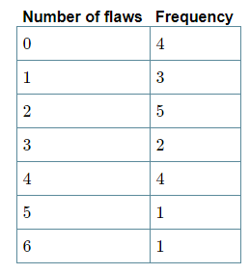
Poisson Distribution – Example 1
Twenty sheets of aluminum alloy were examined for surface flaws. The frequency of the number of sheets with a given number of flaws per sheet was as follows:
What is the probability of finding a sheet chosen
at random which contains 3 or more surface flaws?

Slide 40
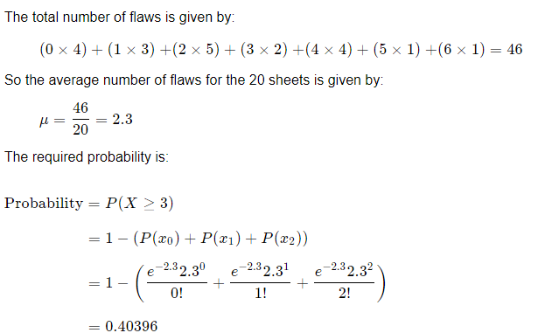
Poisson Distribution – Example 1 with solution

Slide 41
Poisson Distribution – Example 2
Vehicles pass through a junction on a busy road at an average rate of 300 per hour.
Find the probability that none passes in a given minute.
What is the expected number passing in two minutes?
Find the probability that this expected number actually pass through in a given two-minute period.

Slide 42
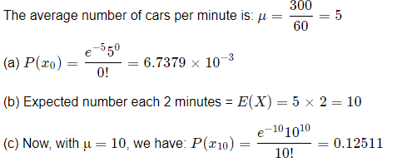
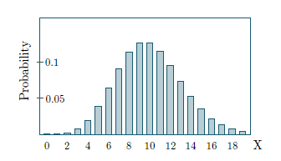
Poisson Distribution – Example 2 Solution

Slide 43
Continuous Probability Distribution

Slide 44
Continuous Probability Function
Assume that to come to this class you travel for 45mins to 1 hour.
If your travel time is a random variable it may take value between 45 and 60 including decimal values.
So the travel time is a continuous random variable.
All the random variables measured on interval and ratio scale are continuous random variables.
For a continuous random variable
The probability at any point is 0. (Area under curve only makes sense)
Only probabilities exist for intervals. We do not talk about probability of RV assuming particular value. We talk about probability for a given interval.
The cumulative probability is equal to 1 i.e. sample space.
The probability density can never be negative.
The probability density can never exceed 1.
Area is a measure of probability.

Slide 45
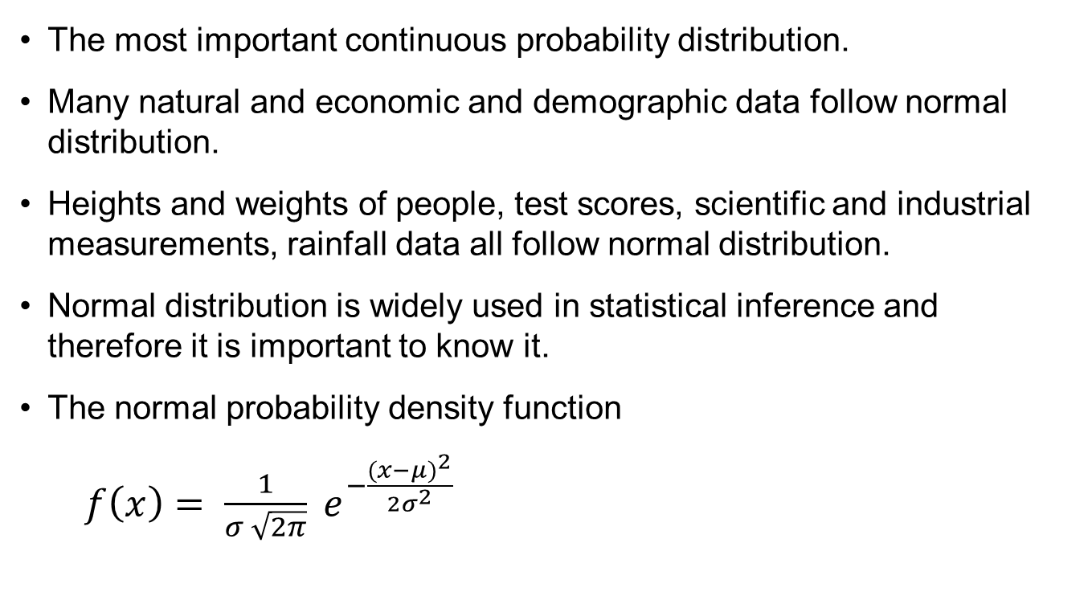
Normal Distribution
The most important continuous probability distribution.
Many natural and economic and demographic data follow normal distribution.
Heights and weights of people, test scores, scientific and industrial measurements, rainfall data all follow normal distribution.
Normal distribution is widely used in statistical inference and therefore it is important to know it.
The normal probability density function
$f\left(x\right)= \frac{1}{σ \sqrt{2π}} e^{−\frac{{(x−μ)}^{2}}{2σ^{2}}}$

Slide 46
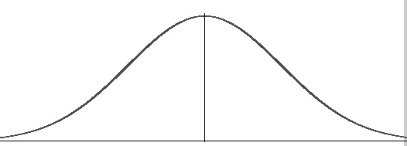
Normal Probability Distribution
The entire family of normal probability distributions is differentiated by its mean and standard deviation.
The highest point of the distribution is the mean which is also the median and mode of the distribution.
The mean can be any numeral +ve, 0 or -ve.
Normal distribution is symmetric on y axis, bisected by mean.
The tails of the curve extend to infinity.
Standard deviation σ
x
mean

Slide 47
Normal Probability Distribution
x
-10
-0
10
Same standard deviation different means
Standard deviation σ = 5
Standard deviation σ = 10
0
x
Same mean different standard deviations

Slide 48
The Normal Curve
68%
95.5%
99.75%
-3σ
-2σ
-1σ
μ
1σ
2σ
3σ

Slide 49
Normal distribution table
z | 0.00 | 0.01 | 0.02 | 0.03 | 0.04 | 0.05 | 0.06 | 0.07 | 0.08 | 0.09
0.0 | .0000 | .0040 | .0080 | .0120 | .0160 | .0199 | .0239 | .0279 | .0319 | .0359
0.1 | .0398 | .0438 | .0478 | .0517 | .0557 | .0596 | .0636 | .0675 | .0714 | .0753
0.2 | .0793 | .0832 | .0871 | .0910 | .0948 | .0987 | .1026 | .1064 | .1103 | .1141
0.3 | .1179 | .1217 | .1255 | .1293 | .1331 | .1368 | .1406 | .1443 | .1480 | .1517
0.4 | .1554 | .1591 | .1628 | .1664 | .1700 | .1736 | .1772 | .1808 | .1844 | .1879
0.5 | .1915 | .1950 | .1985 | .2019 | .2054 | .2088 | .2123 | .2157 | .2190 | .2224
0.6 | .2257 | .2291 | .2324 | .2357 | .2389 | .2422 | .2454 | .2486 | .2517 | .2549
0.7 | .2580 | .2611 | .2642 | .2673 | .2704 | .2734 | .2764 | .2794 | .2823 | .2852
0.8 | .2881 | .2910 | .2939 | .2967 | .2995 | .3023 | .3051 | .3078 | .3106 | .3133
0.9 | .3159 | .3186 | .3212 | .3238 | .3264 | .3289 | .3315 | .3340 | .3365 | .3389
1.0 | .3413 | .3438 | .3461 | .3485 | .3508 | .3531 | .3554 | .3577 | .3599 | .3621
1.1 | .3643 | .3665 | .3686 | .3708 | .3729 | .3749 | .3770 | .3790 | .3810 | .3830
1.2 | .3849 | .3869 | .3888 | .3907 | .3925 | .3944 | .3962 | .3980 | .3997 | .4015
1.3 | .4032 | .4049 | .4066 | .4082 | .4099 | .4115 | .4131 | .4147 | .4162 | .4177
1.4 | .4192 | .4207 | .4222 | .4236 | .4251 | .4265 | .4279 | .4292 | .4306 | .4319
1.5 | .4332 | .4345 | .4357 | .4370 | .4382 | .4394 | .4406 | .4418 | .4429 | .4441
1.6 | .4452 | .4463 | .4474 | .4484 | .4495 | .4505 | .4515 | .4525 | .4535 | .4545
1.7 | .4554 | .4564 | .4573 | .4582 | .4591 | .4599 | .4608 | .4616 | .4625 | .4633
1.8 | .4641 | .4649 | .4656 | .4664 | .4671 | .4678 | .4686 | .4693 | .4699 | .4706
1.9 | .4713 | .4719 | .4726 | .4732 | .4738 | .4744 | .4750 | .4756 | .4761 | .4767
2.0 | .4772 | .4778 | .4783 | .4788 | .4793 | .4798 | .4803 | .4808 | .4812 | .4817
2.1 | .4821 | .4826 | .4830 | .4834 | .4838 | .4842 | .4846 | .4850 | .4854 | .4857
2.2 | .4861 | .4864 | .4868 | .4871 | .4875 | .4878 | .4881 | .4884 | .4887 | .4890
2.3 | .4893 | .4896 | .4898 | .4901 | .4904 | .4906 | .4909 | .4911 | .4913 | .4916
2.4 | .4918 | .4920 | .4922 | .4925 | .4927 | .4929 | .4931 | .4932 | .4934 | .4936
2.5 | .4938 | .4940 | .4941 | .4943 | .4945 | .4946 | .4948 | .4949 | .4951 | .4952
2.6 | .4953 | .4955 | .4956 | .4957 | .4959 | .4960 | .4961 | .4962 | .4963 | .4964
2.7 | .4965 | .4966 | .4967 | .4968 | .4969 | .4970 | .4971 | .4972 | .4973 | .4974
2.8 | .4974 | .4975 | .4976 | .4977 | .4977 | .4978 | .4979 | .4979 | .4980 | .4981
2.9 | .4981 | .4982 | .4982 | .4983 | .4984 | .4984 | .4985 | .4985 | .4986 | .4986
3.0 | .4987 | .4987 | .4987 | .4988 | .4988 | .4989 | .4989 | .4989 | .4990 | .4990

Slide 50
Probability Calculations using Normal Curve
Using standard normal distribution we can find out probability that z assumes certain value.
z | Area = Probability
< 1 | 0.3413 + 0.5 = 0.8413
> 2 | 0.5000 – 0.4772 = 0.0228
1 < z < 2 | 0.4772 – 0.3413 = 0.1359
< -2 | = > +2 = 0.5000 – 0.4772 = 0.0228
-1 < z < -0.5 | = 0.5 < z < 1 = 0.3413 – 0.1915 = 0.1498
-1 < z < 1.5 | = z < 1 + z < 1.5 = 0.3413 + 0.4332 = 0.7745

Slide 51
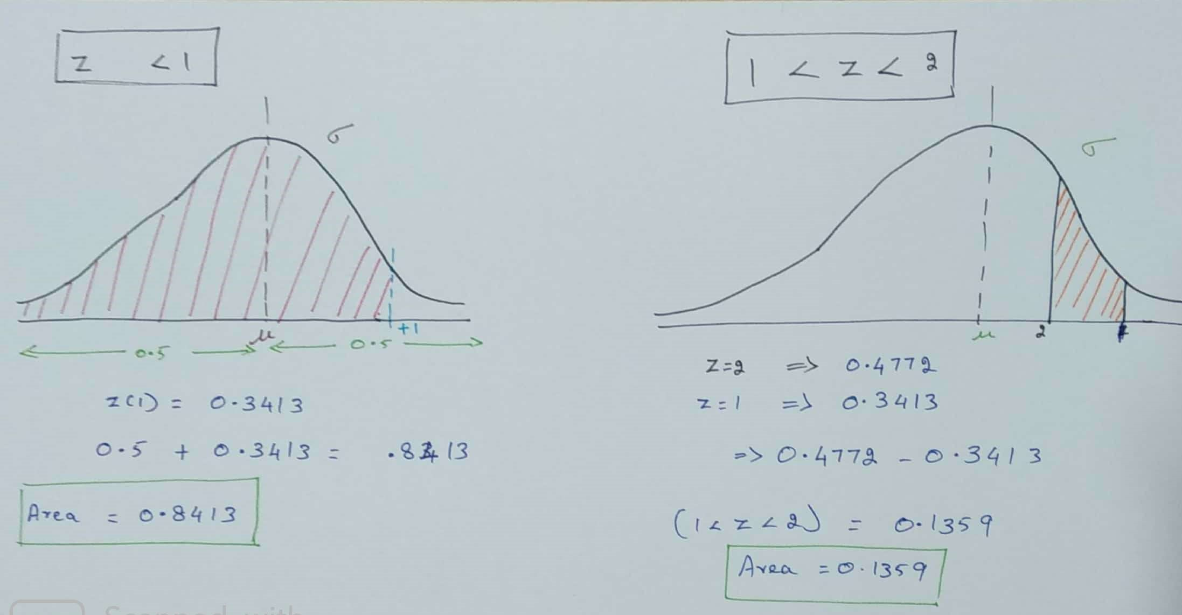
Probability Calculations using Normal Curve
Solution

Slide 52
Sampling

Slide 53
Population
In statistics, the term population is used to describe the subjects of a particular study—everything or everyone who is the subject of a statistical observation.
Populations can be large or small in size and defined by any number of characteristics.
For instance, We want to perform a survey to acknowledge the smoking habit of the women over 18 who buys coffee at Starbucks in New York city.
Here the population contains all the women over 18 who buy coffee at Starbucks in NYC rather than just a population of women over 18 or all the people who buys coffee at Starbucks or all the people in NYC.

Slide 54
Sample
In statistics, a Sample refers to a set of observations drawn from a population.
Often, it is necessary to use samples for research, because it is impractical (time constraints, cost constrain, destructive experiment, etc ) to study the whole population.
For example, suppose we wanted to know the average height of 12-year-old American boys. We could not measure all of the 12-year-old boys in America, but we could measure a sample of boys.

Slide 55
Relation between Population and sample
Consider an example, A crackers company claims to produce a special type of cracker(called whistler-A) that is going to make whistle noise for 30 minutes.
The Population contains the entire production of whistler-A. But it is not possible to burn all the whistler-A that the company produces. So we need to consider a sample from the production of whistler-A. But the sample should be collected properly(randomly) without any biasedness.
Population
Entire production of whistler-A
Sample withdrawn from Population
Estimate the Population by Sample
Sample
A portion(subset) of production of whistler-A

Slide 56
Parameter
A parameter is a measurable characteristic of a population, such as a mean or a standard deviation or something else.
For example, World Health Organization(WHO) wants to publish a record about the average life longevity of Indians.
So the population contains all the age of all Indians.
Now WHO has decided that the mean age could be an appropriate representation of average life longevity.
In this case mean is the Parameter.
Age of all Indians
ƒ = parameter = MEAN

Slide 57
Statistics
A statistics is a measurable characteristic of a sample, such as a mean or a standard deviation or something else.
Why do we need to consider : In many cases it is not possible to consider the entire Population, in that case to estimate the value of the Parameter we use Statistics
For example, World Health Organization(WHO) wants to publish a record about the average life longevity of Indians.
So the population contains all the age of all Indians. It is not possible to consider all the Indians( it requires a lot of time and huge amount of money). So we consider a sample of all the Indians.
Now WHO has decided that the mean age could be an appropriate representation of average life longevity.
In this case mean is the Parameter.
So the Statistics (an appropriate representation of the parameter)will be the mean of the sample.

Slide 58
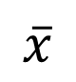
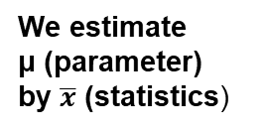
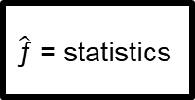
Relation between Parameter and Statistics
Considering mean as the population Parameter
Population
ƒ = parameter
μ
Mean of the Population
We estimate μ (parameter)
by $\overline{x}$ (statistics)
Sample withdrawn from Population
Sample
$\hat{\text{ƒ}}$ = statistics
$$\overline{x}$$
Mean of the Sample

Slide 59
Sampling
A population is the set of all the elements of interest in a study.
A sample is a subset of population.
When selected properly a sample is a representative of the population.
i.e. the characteristics of sample provide an estimate (approximation) of population characteristics.
These characteristics namely mean, standard deviation, variance, median (and a host of others) in the context of population are called parameters and in the context of sample are called statistics.

Slide 60
Statistics – The Big Picture
Sample
Population
Data
1. Produce Data
2. Exploratory Data Analysis
(EDA)
3. Inference
Probability
Inference
Estimation
Hypothesis Testing

Slide 61
Sampling Terminology
Term | Description
Population | Set of all items of interest. Size = N
Sample | A subset chosen from population for study. Size = n
Sampling Unit | An indivisible unit of population liable to be included in the sample set.
Sampling Frame | An object that represents population and facilitates selection of sample set.
Sampling | Selection of n units from N units of population with or without replacement.
Sampling fraction (f) | The ratio f = n / N.

Slide 62
Simple Random Sampling
When we collect sample from a homogeneous population completely haphazardly i.e without any bias from any external source we call it Simple Random Sampling
There are several techniques to select Population elements randomly, such as
Using the help of Random number table
Selecting numbers from a box
We can apply any of them.
There are two types of Simple Random Sampling, such as
Simple Random Sample with Replacement
Simple Random Sample without Replacement
We choose the procedure depending on the appropriate objective and purpose

Slide 63
Simple Random Sampling with Replacement
In this technique, once an unit selected from the population is returned back to the population before the next drawn.
That means, there is a possibility of getting the same unit withdrawn once from the population, again in the sample.
But it is to be noted that the units will be selected randomly from the population.

Slide 64
Simple Random Sampling
Every sample of size n has the same probability of being selected.
If there are N units in population, then all samples of size n have the same probability of 1/(^{N}C_{n}) of getting selected.
Procedure for SRS:
Prepare a unique list of N units of population – sampling frame.
Select n units from the list at random.
Example:
A bank wants to study customer perception of quality of its services to savings account holders. It is decided to go for a sample study. Say there are 1000 account holders and we want to select 50 a/c holders for the study.

Slide 65
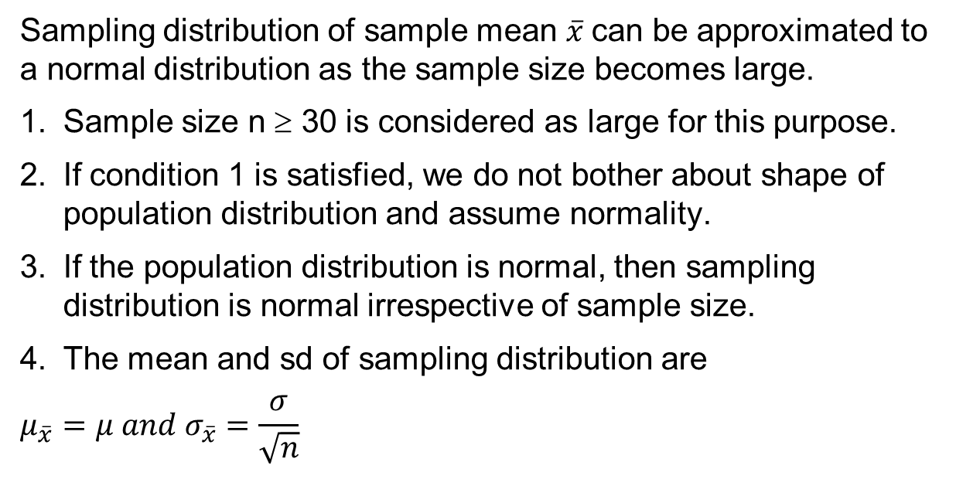
Sampling Distribution
Sampling distribution of sample mean $\overline{x}$can be approximated to a normal distribution as the sample size becomes large.
Sample size n ≥ 30 is considered as large for this purpose.
If condition 1 is satisfied, we do not bother about shape of population distribution and assume normality.
If the population distribution is normal, then sampling distribution is normal irrespective of sample size.
The mean and sd of sampling distribution are
$$μ_{\overline{x}}=μ and σ_{\overline{x}}=\frac{σ}{\sqrt{n}}$$
μ

Slide 66
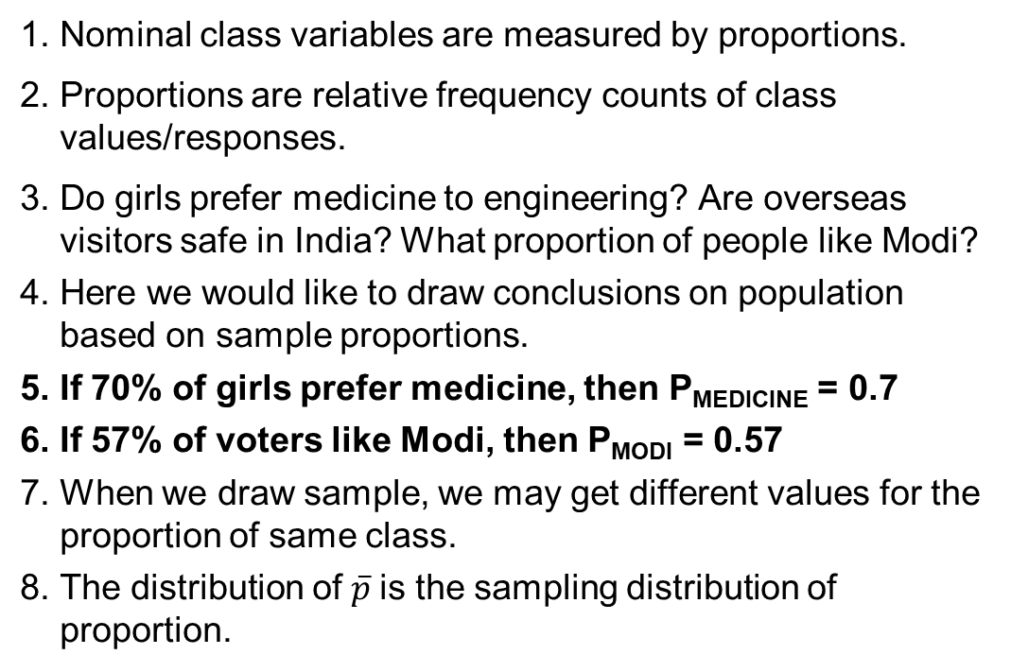
Sampling Distribution for Sample Proportion
Nominal class variables are measured by proportions.
Proportions are relative frequency counts of class values/responses.
Do girls prefer medicine to engineering? Are overseas visitors safe in India? What proportion of people like Modi?
Here we would like to draw conclusions on population based on sample proportions.
If 70% of girls prefer medicine, then P_{MEDICINE} = 0.7
If 57% of voters like Modi, then P_{MODI} = 0.57
When we draw sample, we may get different values for the proportion of same class.
The distribution of $\overline{p}$is the sampling distribution of proportion.

Slide 67
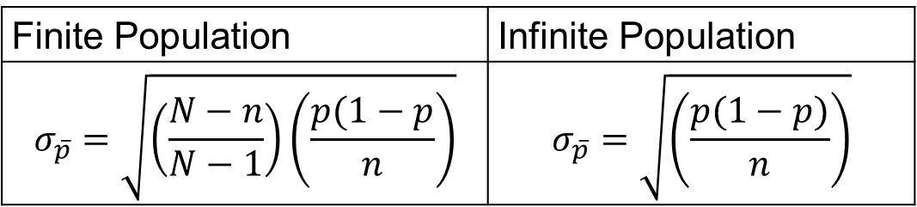
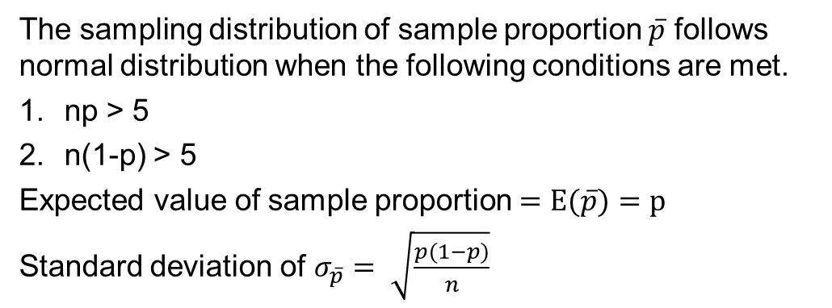
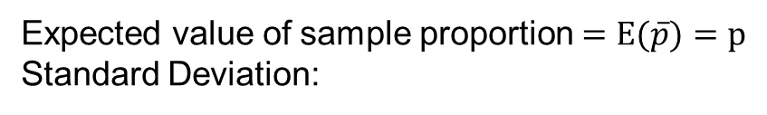
Statistics for Proportions
Expected value of sample proportion $=E(\overline{p})=p$
Standard Deviation:
Finite Population | Infinite Population
$$σ_{\overline{p}}=\sqrt{\left(\frac{N−n}{N−1}\right)\left(\frac{p(1−p}{n}\right)}$$ | $$σ_{\overline{p}}=\sqrt{\left(\frac{p(1−p)}{n}\right)}$$
The sampling distribution of sample proportion $\overline{p}$ follows normal distribution when the following conditions are met.
np > 5
n(1-p) > 5
Expected value of sample proportion $=E(\overline{p})=p$
Standard deviation of $σ_{\overline{p}}= \sqrt{\frac{p(1−p)}{n}}$

Slide 68
Central Limit Theorem

Slide 69
Central Limit Theorem
If sample random sample of size n is selected for a distribution with mean and standard deviation, then the distribution of the sample mean approach a normal distribution, irrespective of parent distribution of population.
The greater the sample size, better is the approximation ( typically n >= 30)

Slide 70
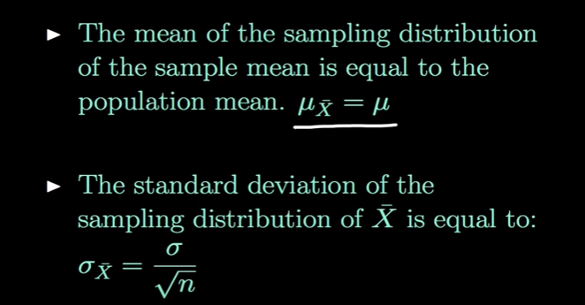
Central Limit Theorem – Key Points

Slide 71
CLT - Mean
Manual calculation, to prove Sample mean is
Equal to population mean
 | Input | Sample | Mean
 | 3 | s1 | 3.5
 | 4 | s2 | 5
 | 6 | s3 | 4
 | 2 | s4 | 3
 | 4 | s5 | 4.5
 | 5 | s6 | 6.5
 | 8
Mean of Population | 4.571 | Mean of Sample Means | 4.417
 | S1 = (3 +4)/2 = 3.5

Slide 72
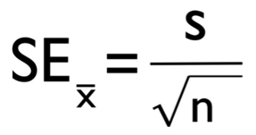
CLT – Standard deviation
Standard error is the standard deviation of the sampling distribution of a statistic. It can be abbreviated as S.E.
The statistical inference involved in the construction of the confidence interval is mainly based on standard error.
S is std deviation, n sample size
 | Dataset 1 | Dataset 2
 | 9 | 10.9
 | 15 | 11.9
 |  | 12.2
 |  | 12.2
 |  | 12.9
 |  | 12.6
 |  | 12.3
 |  | 12.3
 |  | 12.5
 |  | 10.2
Mean | 12 | 11.4
Std dev | 4.242641 | 0.825967
Std error = std dev / sqrt(n) | 3 | 0.261194

Slide 73
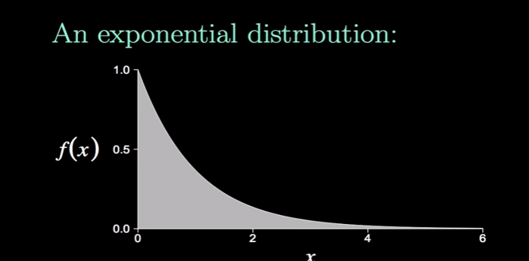
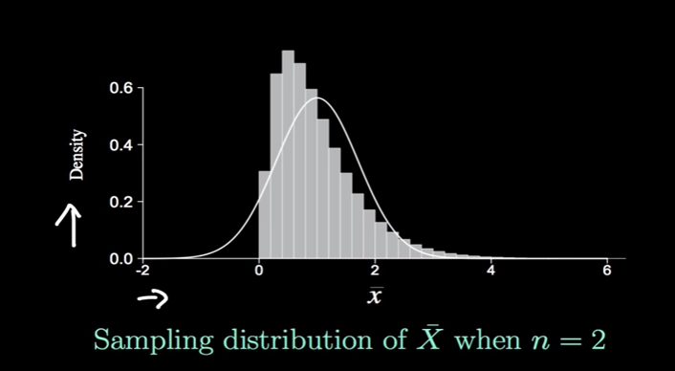
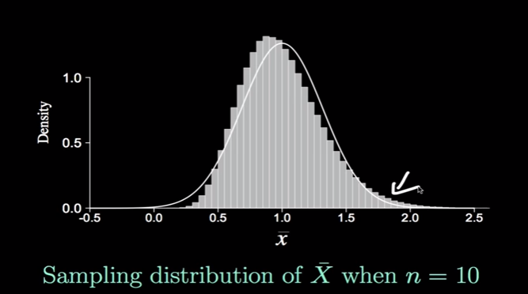
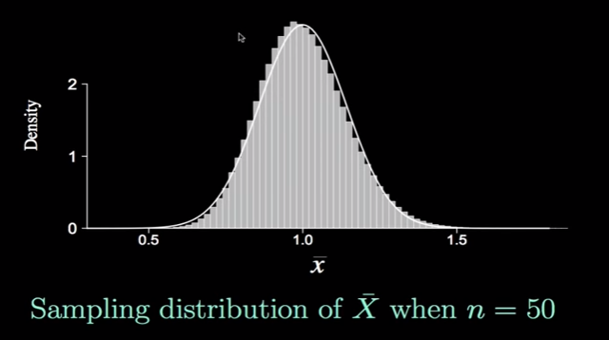
Central Limit Theorem – Graph based on samples
Sample mean to be appr. Normal distributed, sample size should be >= 30

Slide 74
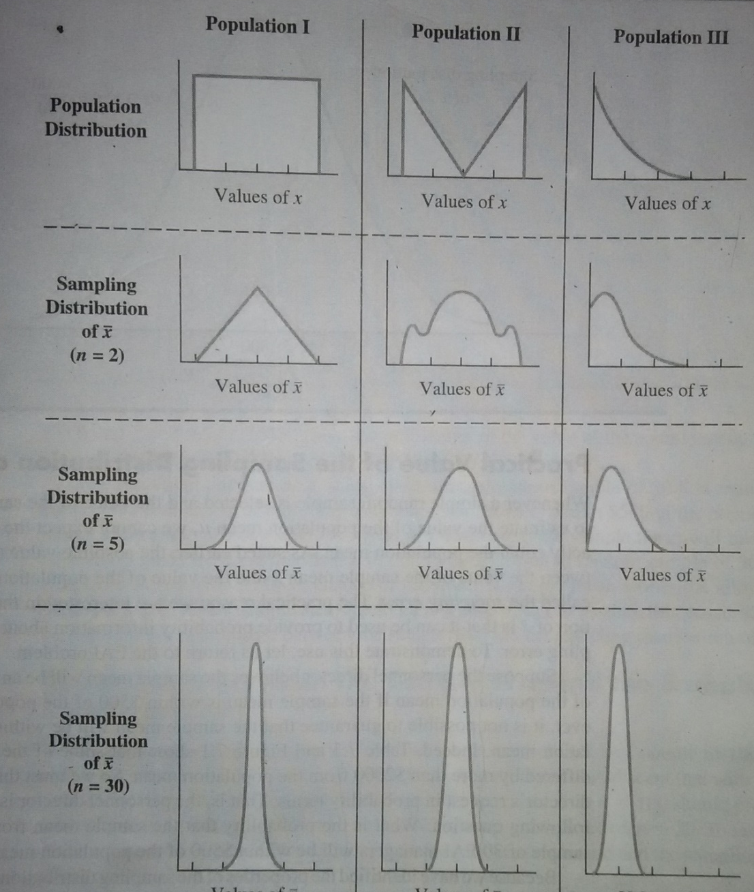
Central limit Theorem
When Central Limit Theorem is applicable, normality of population shape is not required.

